Slide 1
Environment and AI
Andreas, Jybz, Saurav

Slide 2
Domotique(Smart home)
We can use ESP8266 for controlling any light emitting thing and their colors.
We will provide the API for controlling it.
Countdown timer.

Slide 3
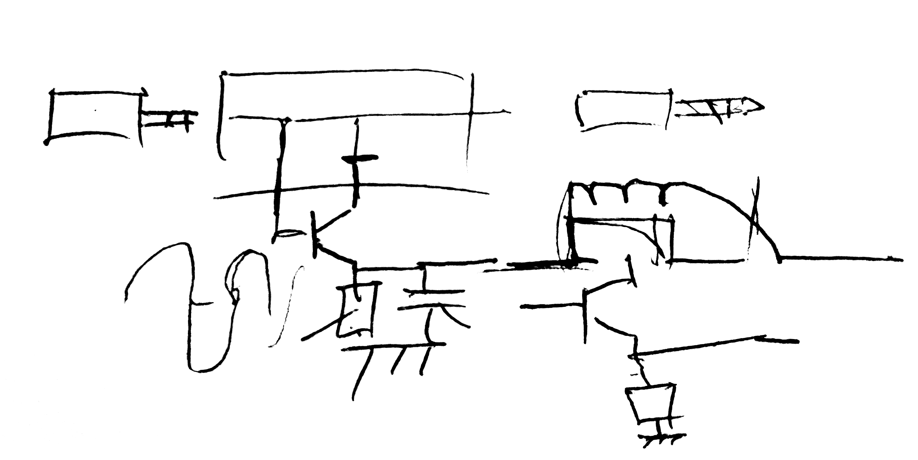
AI – Speech input (Ideas)
Hacking into walkie-talkie and sending input to the SBC.
Wireless mic to get the input.
Last resort – omnipresent microphone.
Using signal filter(image) to notify SBC to start listening.
Something like “Ok Google”, “Hey Siri” or “Alexa”. Maybe, “STASSIS” in our case.

Slide 4
AI – speech Recognition
Google API.
Couple of drawbacks like active internet connection, API limit and not FREE.
Pricing – Free for first 60 minutes. Thereafter, $0.006/15 seconds.
So, for 31 hours of voice recognition, the cost would be $ 7.20.
Mozilla DeepSpeech.
Standalone system. Pre-trained model is available.
After couple tests, it can’t fully recognize the sentences.
Background noise and different accents can aggravate this.
Might have to train our own model.

Slide 5
AI – processing questions and answers
What kind of questions should it answer?
Do we need a chatbot?
Should it also give feedback? E.g. “server room compromised”, “catastrophic failure” etc.

Slide 6
AI – Text to Speech
Using pico/espeak on the SBC.
Need to explore more.
Should be easier compared to other two tasks.

Slide 7
Squeezing ceiling (not for our group)
Long shot
Carton/paper false ceiling above the room.
Controlled by motors and pulleys.
Comes down with time or someone does something wrong.
Like, miss answering your favorite color
Wrong attempts for solving the puzzles.

Slide 8
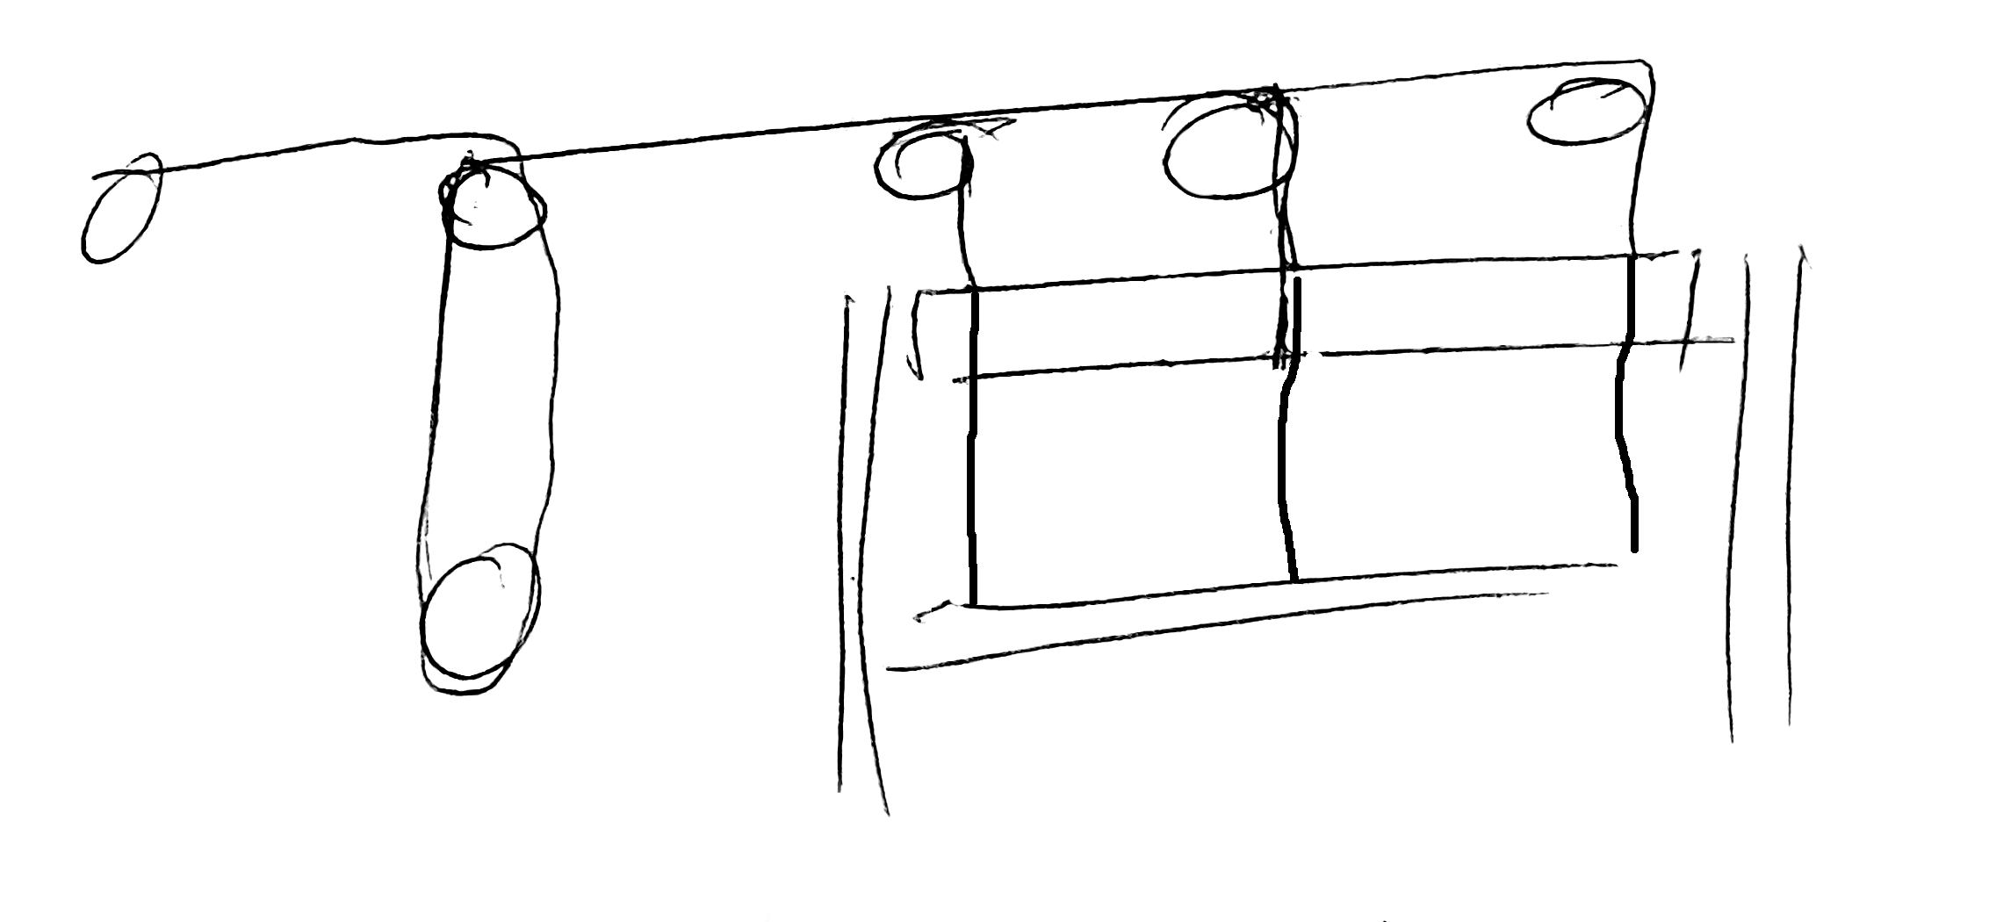
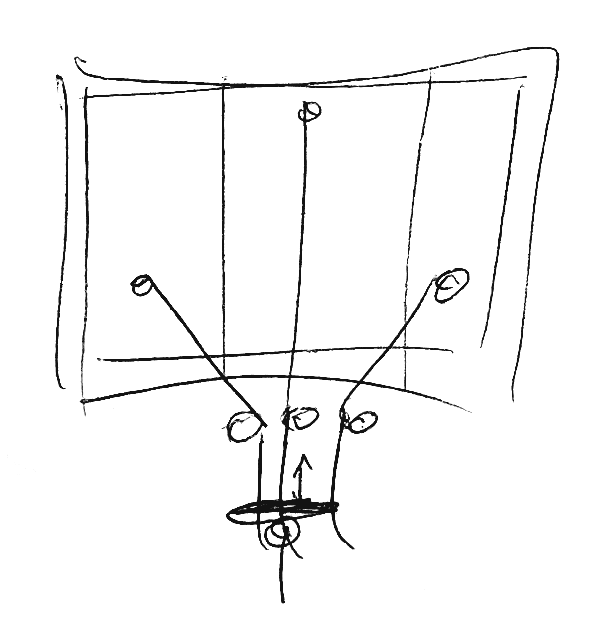
Illustrations

